Slide 1

Inspired XPress
On Demand Tutorial
Notes:
Hello and welcome to AMX University and this On Demand tutorial, “Getting Started with Inspired XPress”. This tutorial introduces AMX Inspired XPress. We will identify Inspired XPress, explain how it works, discuss its features and talk about its benefits, uses and markets. At the end of this tutorial there will be a short quiz in order to get credit for this course.

Slide 2



AMX Inspired Signage Решения
Простой и многогранный
Всё-в-одном и интуитивный инструментарий
Легкосоздаваемые шаблоны и контент
Ультра компактный и экономически оправданный
XPress
Комплексное предложение
Готовые шаблоны и расположения с анимацией
Направленный на образование, рекламу и корпоратив
Управляйте контентом в зависимости от задачи.
XPert
Полное решение
Решение с пользовательским дизайном
Уникальная анимация
Продвинутая архитектура
Notes:
AMX offers Digital Signage Solutions that meet a variety of user needs. The AMX Inspired Signage Solutions consists of Inspired Xpress, Inspired 2 Go and Inspired Signage. Inspired XPress is a simple yet versatile solution that uses a drag and drop software tool to create content quickly and easily. The small, cost-effective players mount behind any display. Inspired-2-Go is a bundled offering that allows you to customize pre built templates and layouts with your own content. Inspired Signage is a robust solution for users requiring complex customization such as unique animation and advanced design.

Slide 3
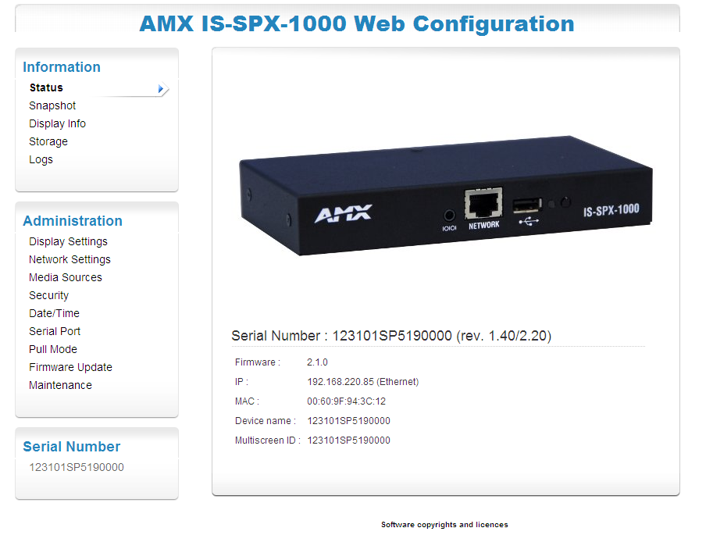
Что такое Inspired XPress?
Digital Signage для пользователей, которые хотят управлять всеми аспектами контента, включая его создание
Всё-в-одном
  Создавать шаблоны
  Создавать контент
  Публиковать контент
Ультра компактный
  Устанавливается везде
Гибкий дизайн контентаent Design
Notes:
Inspired XPress is for users that want to manage all aspects of their digital signage including content creation with a flexible and intuitive software interface. Cleverly designed into a small form factor, Inspired XPress features a simple, all-in-one software tool that allows users to quickly and easily create templates and content, and then publish that content to players which are small enough to mount behind any display. Content design is fluid, more like a web page than a standard digital signage template which has defined fields.

Slide 4
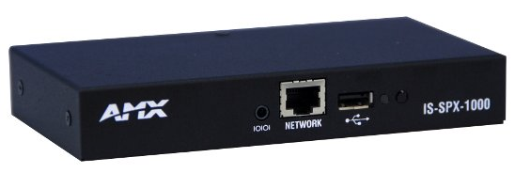
Inspired XPress Player
Характеристики:
  Вес: 272 грамм
  Часы в реальном времени
  Встроенная 2GB флеш-память
  Подключение «флешки» и внешнего жёсткого диска через USB
158.75mm
82.80mm
25.4mm
IS-SPX-1000
Notes:
The Inspired Xpress player has Dimensions of 1.0” high x 6.25” wide and 3.26” deep (25.4mm x 158.75mm x 82.80mm). It weights 0.60 (six tenths or sixty one-hundredths) of a lb and has a real-time clock. The XPress player also includes Internal storage of 2GB solid state. External storage consists of Flash drives and hard disks via USB 2.0 port

Slide 5
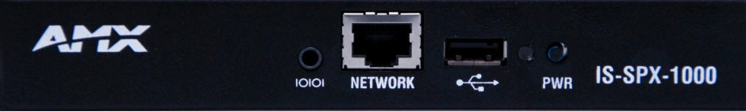
Front Panel Components
RS232
USB
Power/ Reset
Ethernet
Status
Notes:
The Inspired Xpress Player Front Panel Components consists of
a RS232 Interface in mini-jack format with up to 115200 (one fifteen two) baud for Development use.
An Ethernet RJ45 jack.
A USB 2.0 Connector for use with Flash drives and hard disks for additional external storage.
The status LED displays the status of the device.
and the Power/Reset button for rebooting the device.

Slide 6
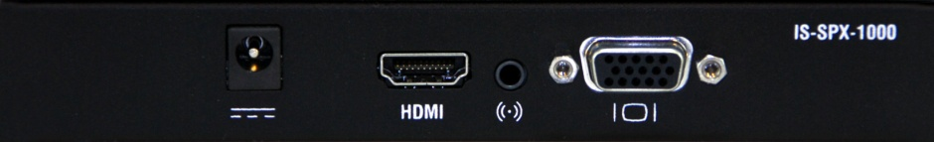
Back Panel Components
DC Power
Audio Out
HDMI
Video Out
AC Power cord provided
Notes:
The XPress Player Back Panel Components include
A 5V-DC Power jack with a provided AC Power cord in order to plug the device into an AC outlet.
A HDMI connector with DVI available via an adapter.
An Analog Audio Out
And an Analog Video Out

Slide 7
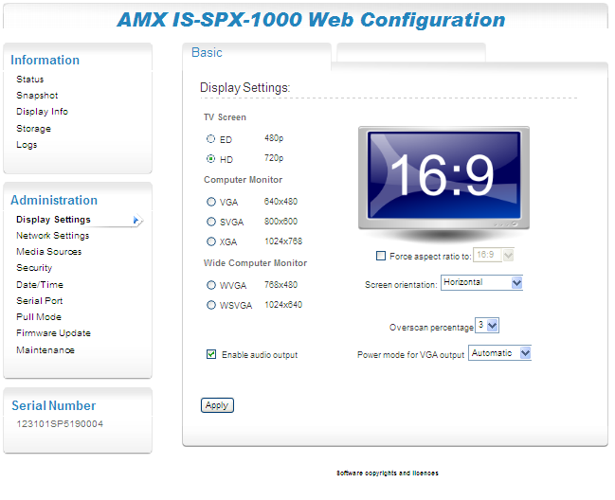
Простое Web конфигурирование
Notes:
Inspired XPress has simple and easy to use web configuration.

Slide 8


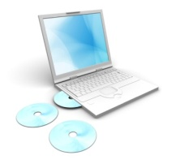
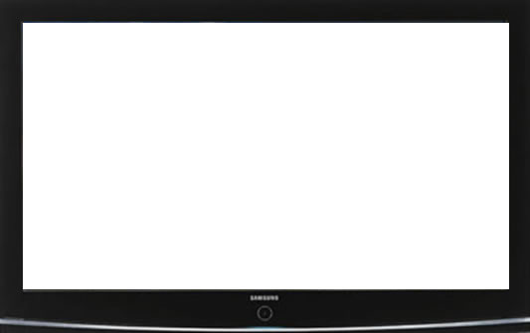
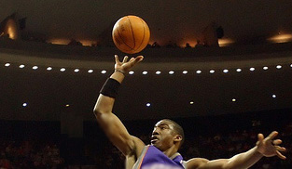




Как это работает?
ТВ поток
On-line Video поток
On-line RSS модули
IS XPress ПО
Men's Basketball
Game
Barrington Gym
Tuesday, October 10
6:00pm
Weather
Monday
High 83° F
Low 68° F
Wind 12 mph
SPX-1000 плееры
Auto Show
Penn Center
December 10-12
9:00am – 9:00pm
Сетевое Хранилище
Конфигурирование
Контент
Статус
Интернет Ресурсы
Базы Данных
Notes:
The IS XPress Software is used to configure each player to display content from a variety of network resources in different configurations. The same content can be sent to one or multiple units. Each IS-SPX-1000 unit can be monitored in real time from the IS XPress Software.

Slide 9
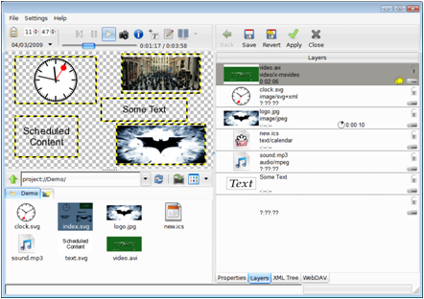
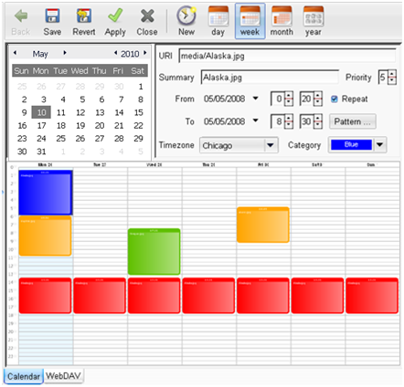
Ключевые особенности
Простое в использовании ПО
Гибкая интеграция данных
Стандартная архитектура
Быстрые проф. сообщения
Интуитивное расписание
Живое видео& поддержка PowerPoint
Конвертирование PPT
Снятие «скриншотов»
HDMI и VGA выходы
Работает с 2 Вт.
Интерфейс
Расписание Эвентов
Notes:
A key feature of Inspired XPress is the software. It allows a user to both create their content as well as manage its distribution. The software also allows users to setup and manage the players.
Inspired XPress supports RSS Feeds for News, Weather, Sports or any other information that can be obtained via RSS Feed.
The software uses standards based technology such as Scalable Vector Graphics (SVG) and XML. SVG produces graphics that are smaller, transmit more quickly, and are scalable without loss of resolution.
The design aspect of the software tool allows users to quickly create professional looking messages using content they already have developed such as JPEG, GIF or MPEG files.
Scheduling software includes a simple drag-and-drop solution for creating schedules for playlists. It allows a day, week, month or yearly view to quickly provide an overview of what is scheduled to play. Users can simply click and drag to extend the time of a playlist or to move a playlist from one day to another.
Live video streams can be played allowing for a live video multicast of content from a network video source such as AMX’s Vision² in Standard Definition.
The Inspired XPress software can convert PowerPoint presentations into messages.
Inspired XPress allows a user to take a snapshot of an image to view exactly what is being shown on the end display for status or reporting purposes.
The player features 2 output connections which are both active, allowing it to feed two displays the same message simultaneously.
and The player uses only 2 watts of power, combined with it’s small size, it is perfect for mobile installations.

Slide 10
Ключевые особенности
Нет подвижных частей
Может быть интегрирован
Маленький форм-фактор и потребление
USB интерфейс
Поддерживает внешние устройства
Работает с любыми браузерами
Удалённый монитор
Маленький форм-фактор
XPress Программное обеспечение
Сеть
Notes:
Inspired Xpress:
Contains no moving parts and is engineered to be used wherever digital signage displays are utilized
It Can be integrated behind displays, beneath a technical floor, or in a custom enclosure
Inspired XPress has Small form factor and a low power draw
The USB interface can be used to extend the internal storage through memory sticks or hard drives
It Supports external devices such as touch screen controllers or keyboards
Any web browser can be used to connect to the hardware IP address
You can Remote monitor the status of the hardware and configure specific parameters

Slide 11
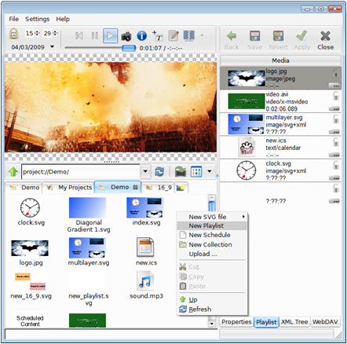
Преимущества
Гибкий дизайн контента
Солидные устройства оповещения
Поддержка русского языка
Лёгкая установка
Маленький и мощный
«Зелёный» дизайн
Flexible Content Design
Small but POWERFUL
Notes:
Flexible Content Design – The software used to build messages allows flexibility to position text, images and video anywhere on the screen, providing a blank canvas for users to design their messages much like a web page. A preview feature allows you to see what your content will look like before it is published.
Robust Reporting Tools - Inspired XPress can generate reports showing what messages were run and for how long. This allows documentation of messages played for compliance or advertising tracking.
Multiple Language Support – Inspired XPress can support international languages including Chinese, Japanese and Arabic. It can play text from left to right, right to left, top to bottom or bottom to top. The software includes basic fonts for several languages and allows users to load customizable fonts to support corporate branding.
Installs Easily – The device is automatically discovered when it is connected to a network for easy installation. It can also be set to automatically convert messages to the aspect ratio and orientation of the display.
Small and Powerful Player – By designing the player to be small, light and with no moving parts, it can easily be mounted behind a display. However, this small player is packed with capabilities that most PC-based digital signage solutions cannot match including support for live video and video walls.
Green Design – The efficient design requires only 2 watts of power, reducing energy costs.

Slide 12
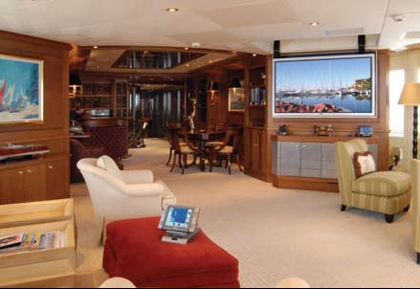
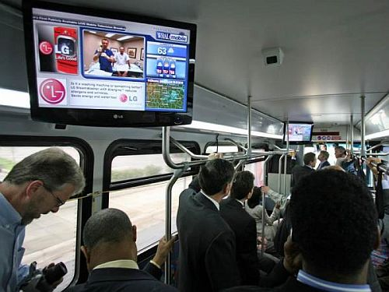
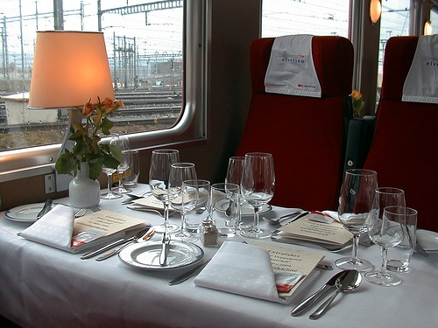
Использование
Приложения для наружных дисплеев
Видео стены
Киоски
Катера, лодки, поезда.
Тур-фирмы, фитнесс-центры, центры общепита.
Notes:
Applications where the player will be mounted at the display is perfect for this small device, even with little clearance or ventilation. Using the time-synchronization capabilities, multiple players can be used to create a unified message on a video wall, or a touch screen can drive the player for Kiosk applications.
It’s small size makes it perfect for mobile vehicles.

Slide 13
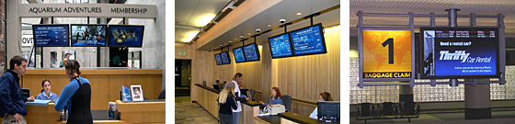
Рынки
Розничные сети
  Рекламировать продукты или акции
Отели
  Продвигать ежедневные мероприятия или сервисы.
Казино и Стадионы
  Рекламировать специальные мероприятия или направления
Рестораны
  Цифровые меню
Банки
  Продвигать финансовые сервисы и котировки
Корпоратив
  HR сообщения или тренинги
Notes:
Inspired XPress can be used in any vertical application to provide dynamic messaging to an audience. Retailers can advertise products or specials, Hotels can promote daily events or services, Casinos and Stadiums can advertise special events or directions, Restaurants can digitize menus, Banks can promote financial services or daily rates, Corporations can deliver employee notifications or training information, and the list goes on.

Slide 14
Inspired XPress
End of Session
Notes:
Thank you for your participation. This concludes the “Getting Started with Inspired XPress” tutorial. To receive credit for this course, pass the following quiz with a score of 80% or higher.

